Slide 1


Department of Computer Science and Engineering
GE 19612 - Professional Readiness for
Innovation, Employability and Entrepreneurship
JOB RECOMMENDATION SYSTEM
Akalya G
210701021
Aravind S
210701033
Dr. T. Kumarakurubaran., M.Tech., Ph.D AP(SG)
PROJECT COORDINATOR

Slide 2
Abstract
In today's dynamic job market, career guidance is vital for aligning individuals with suitable opportunities. This project develops a skill/job recommender application using AI and open-source data. The web-based platform assesses users' skills through questions for accurate recommendations.
The AI-driven engine matches users with career paths based on their skills, interests, and market demand. The application offers curated educational resources and integrates a chatbot for personalized guidance from professionals. By leveraging technology, this project empowers aspiring youth to make informed decisions and pursue meaningful career opportunities.

Slide 3
Existing System
The existing systems primarily offer job recommendations based on user searches, but they often lack comprehensive guidance for further skill development. These platforms do not provide adequate resources for users to enhance their knowledge in the recommended skill sets. Additionally, they fall short in facilitating effective communication between skilled professionals and users seeking advice. There is a significant gap in providing a holistic career development experience, encompassing not just job matching, but also continuous learning and mentorship opportunities. This highlights the need for a more integrated platform that combines job recommendations, skill enhancement resources, and direct access to expert guidance.

Slide 4
Proposed System
The proposed system aims to address the limitations of existing platforms by offering a comprehensive career guidance solution. It features an AI-driven job recommendation engine that matches users with suitable career paths based on their skills, interests, and market demand. The platform assesses users' knowledge and skills through a series of questions and enhances accuracy by using UiPath automation to extract skillsets from resumes.
Beyond job matching, the system provides curated links to educational resources, notes, and websites, empowering users to improve their skills and knowledge in their chosen fields. It also integrates a chatbot for personalized guidance, enabling direct interaction with skilled professionals for advice and mentorship.
By combining job recommendations with continuous learning and expert support, the proposed system aims to empower users to make informed career decisions and pursue meaningful opportunities, addressing the gaps in current career guidance platforms.

Slide 5
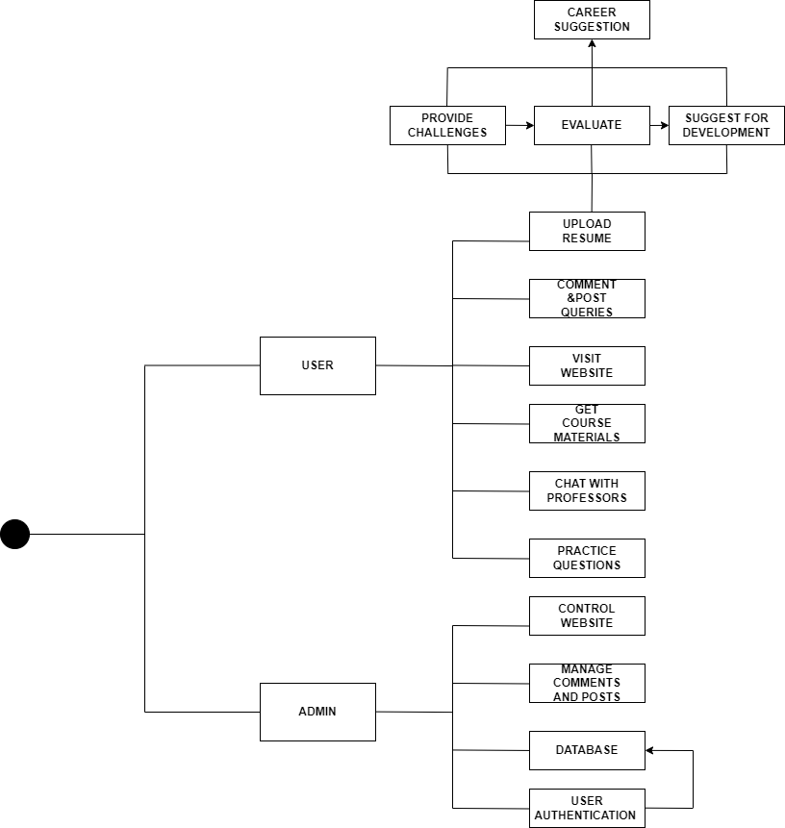
System Architecture

Slide 6
List of Modules
User Profile Module
Resume Parsing Module
AI-Driven Job Recommendation Engine
Educational Resources Module
Mentorship and Guidance Module

Slide 7
Functional Description for each modules
User Profile Module:
Functionality: Users create profiles detailing their professional background, skills, education, and career aspirations.
Elaboration: This module collects comprehensive information about users to tailor recommendations effectively. It may include sections for users to input their past job titles, industries they've worked in, educational qualifications, certifications, and specific skills they possess.

Slide 8
Functional Description for each modules
Resume Parsing Module:
Functionality: Automatically extracts and analyzes key information from user-uploaded resumes.
Elaboration: Utilizing technologies like natural language processing (NLP) and machine learning, this module scans resumes to identify skills, work experience, education, and achievements. It ensures that users' profiles are accurately represented and that job recommendations are aligned with their qualifications.

Slide 9
Functional Description for each modules
AI-Driven Job Recommendation Engine:
Functionality: Matches users with relevant job opportunities based on their profiles, skills, and preferences.
Elaboration: This module employs sophisticated algorithms to analyze user data, job postings, and market trends. It considers factors such as location, salary expectations, career level, and industry preferences to provide personalized job recommendations. It continually learns from user interactions to improve accuracy over time.

Slide 10
Functional Description for each modules
Educational Resources Module:
Functionality: Provides access to curated educational materials, courses, and resources.
Elaboration: Users can explore a variety of learning resources, including online courses, tutorials, e-books, and articles, relevant to their career interests. The module may offer recommendations based on users' skill gaps identified during assessments, ensuring they have access to the knowledge needed to succeed in their chosen fields.

Slide 11
Functional Description for each modules
Mentorship and Guidance Module:
Functionality: Facilitates direct communication between users and experienced professionals for mentorship.
Elaboration: Users can connect with mentors or industry experts through messaging platforms, video calls, or community forums. They receive personalized guidance, career advice, and insights into industry trends. Mentors may offer career coaching, networking opportunities, and support for professional development.

Slide 12

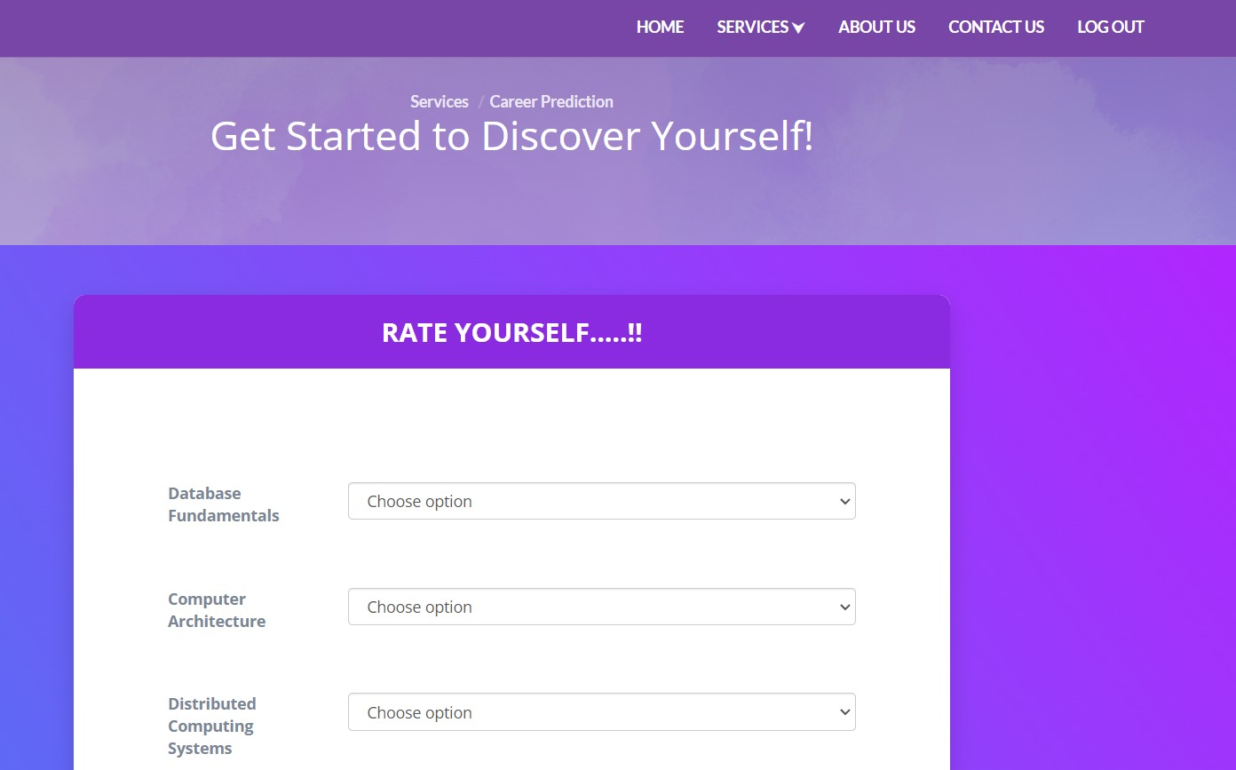
Output

Slide 13
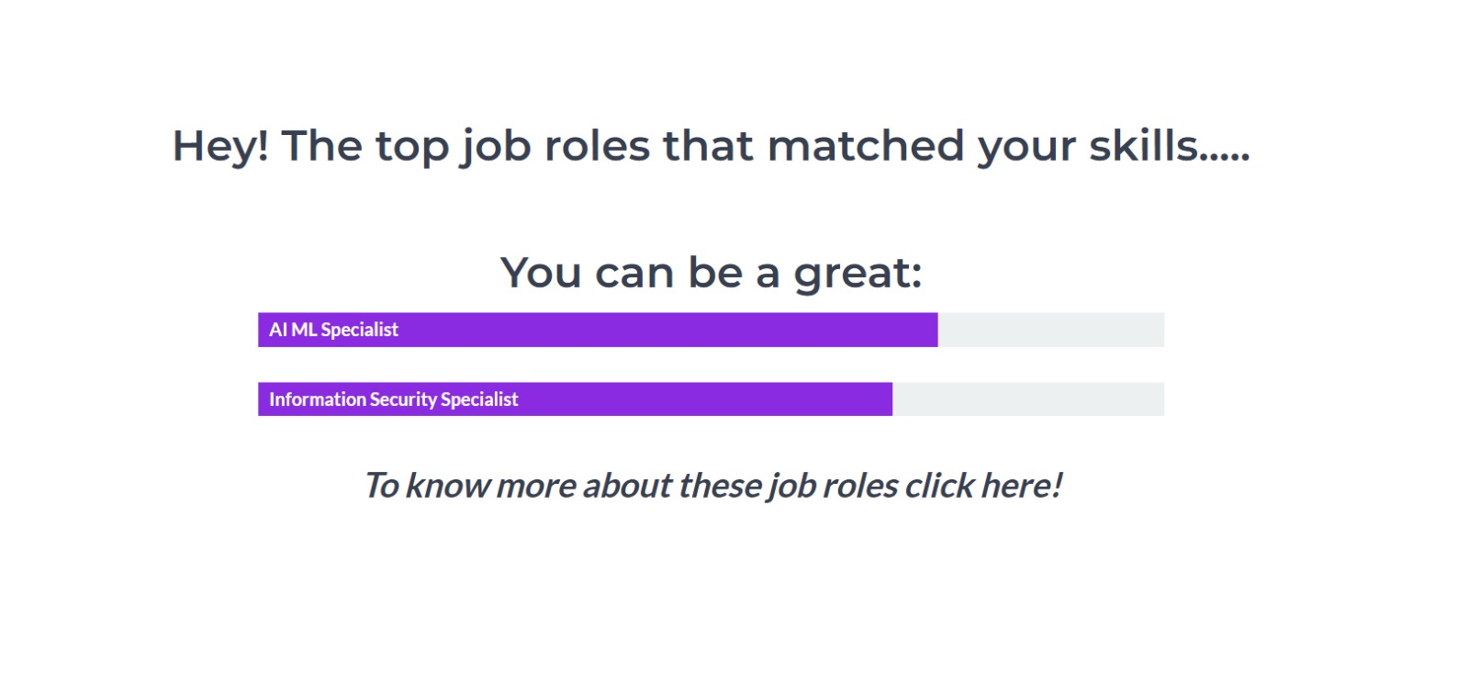
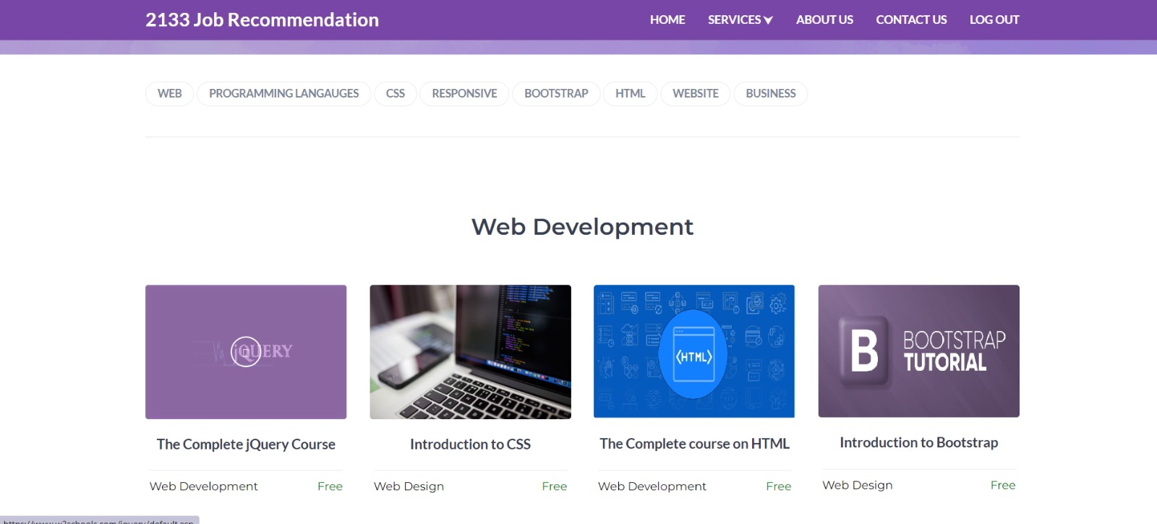
Output

Slide 14
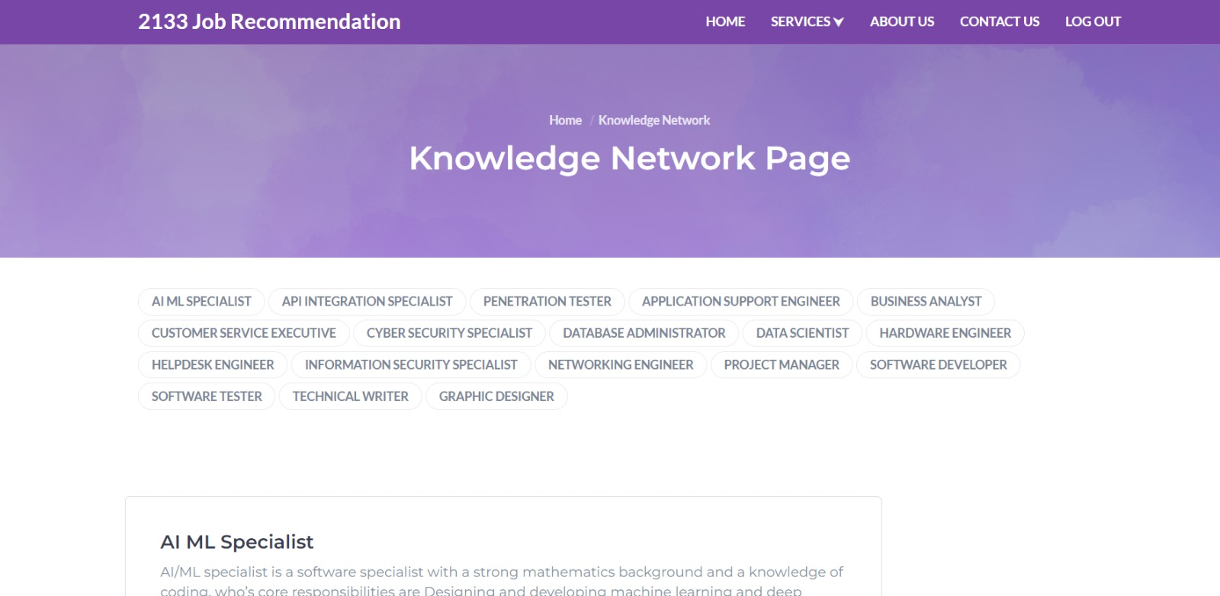
Output

Slide 15
Conclusion
In conclusion, the development of the skill/job recommender application marks a significant milestone in modernizing career guidance and job matching processes. By leveraging advanced technologies such as AI, open-source data, automation, and personalized guidance, the application empowers individuals with the tools and resources needed to navigate the complexities of the job market effectively. Through personalized job recommendations, access to curated educational resources, and interactive support mechanisms, the application facilitates efficient employment and fosters continuous learning and professional growth. Overall, the project demonstrates the transformative potential of technology in empowering individuals to make informed decisions and pursue rewarding career opportunities.

Slide 16
References
Z. Batmaz, A. Yurekli, A. Bilge, and C. Kaleli, ‘‘A review on deep learning for recommender systems: Challenges and remedies,’’ Artif. Intell. Rev., vol. 52, no. 1, pp. 1–37, Jun. 2019.
Q. Guo, F. Zhuang, C. Qin, H. Zhu, X. Xie, H. Xiong, and Q. He, ‘‘A survey on knowledge graph-based recommender systems,’’ IEEE Trans. Knowl. Data Eng., vol. 34, no. 8, pp. 3549–3568, Aug. 2022.
J. Han, L. Zheng, Y. Xu, B. Zhang, F. Zhuang, P. S. Yu, and W. Zuo, ‘‘Adaptive deep modeling of users and items using side information for recommendation,’’ IEEE Trans. Neural Netw. Learn. Syst., vol. 31, no. 3, pp. 737–748, Mar. 2020.
G. Adomavicius and Y. Kwon, ‘‘Improving aggregate recommendation diversity using ranking-based techniques,’’ IEEE Trans. Knowl. Data Eng., vol. 24, no. 5, pp. 896–911, May 2012.

Slide 17
Thank You

